Slide 1
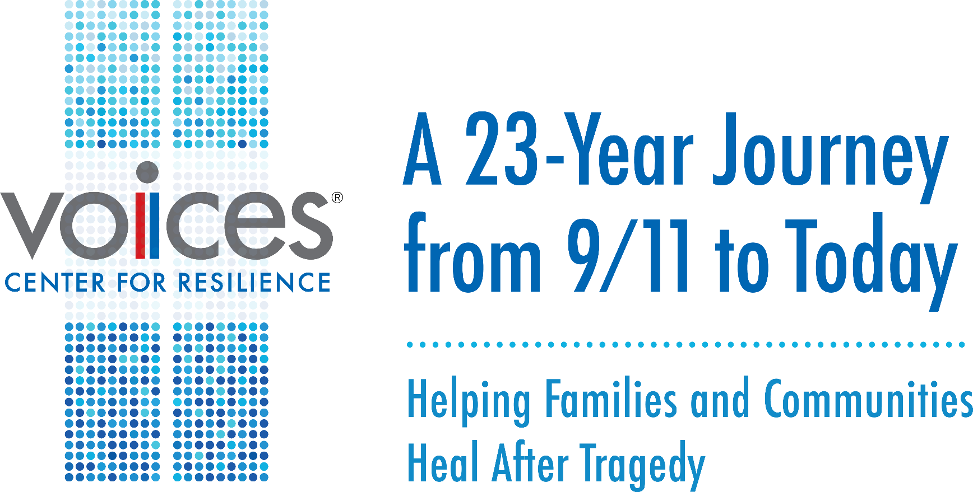
National Counter Terrorism Center
Washington, DC
January 10, 2024
Mary Fetchet, LCSW, Founding Director
Frank Fetchet, Chief Operating Officer

Slide 2













2
1
Our personal story
2
History and Impact of 9/11
3
Advocacy Efforts, Commemoration
4
Looking ahead

Slide 3
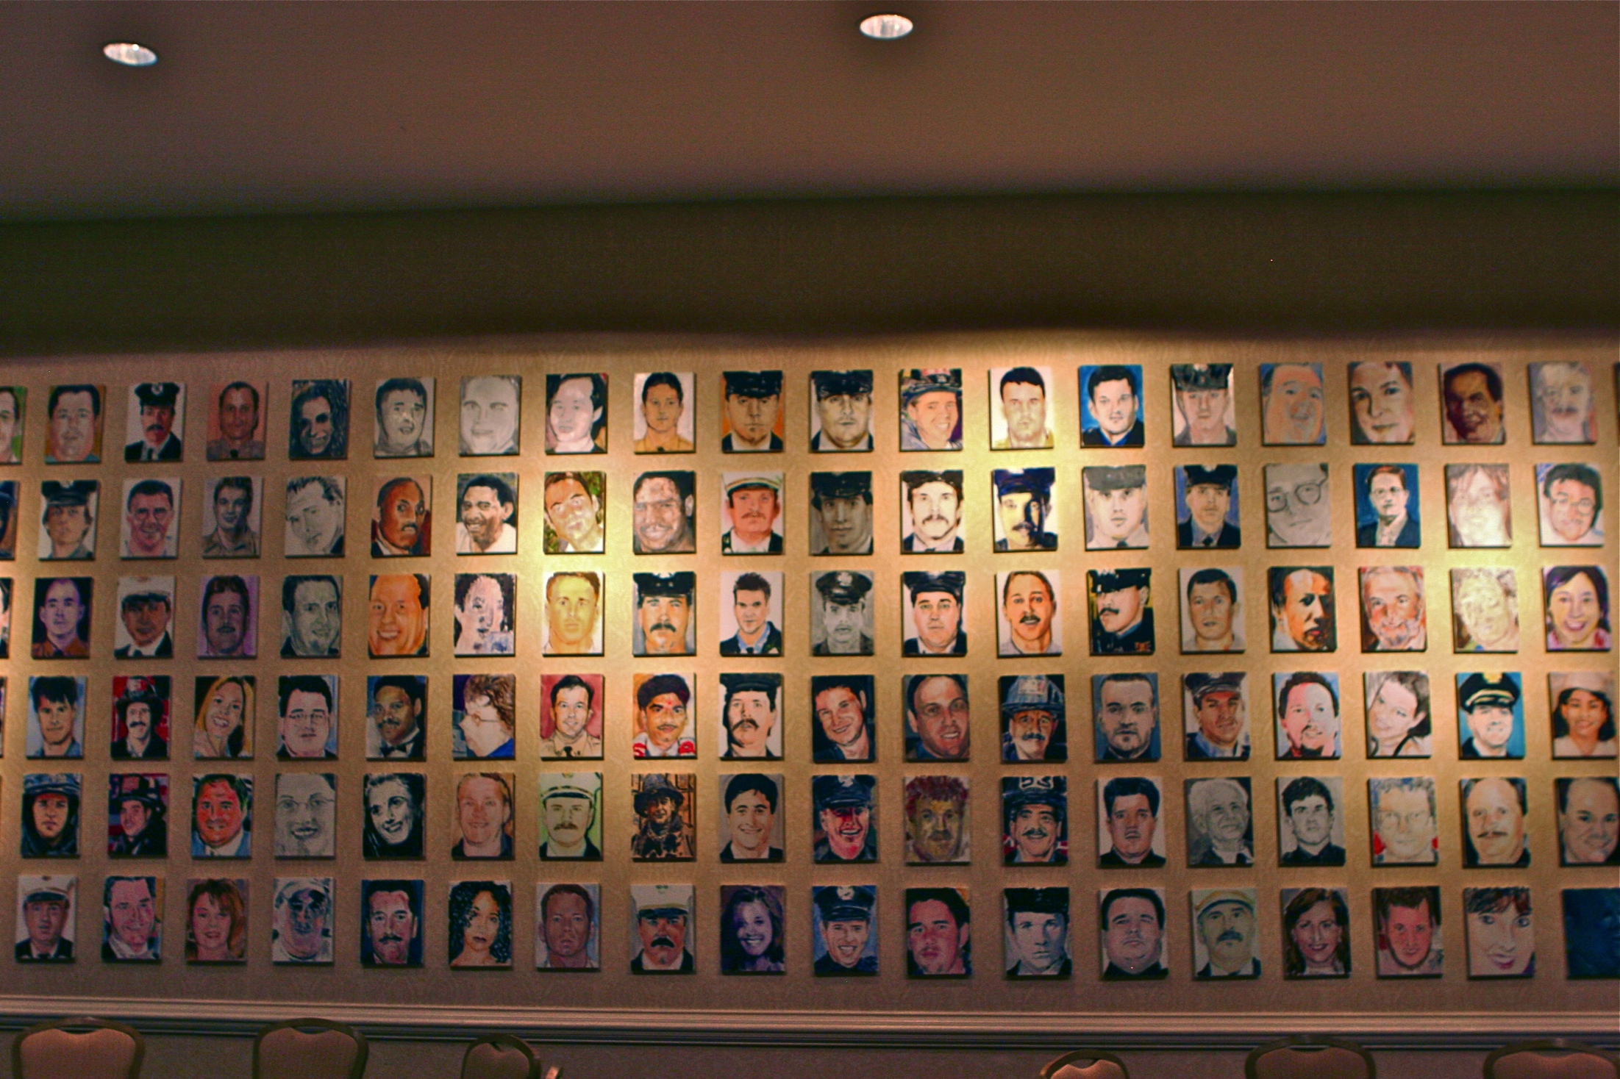
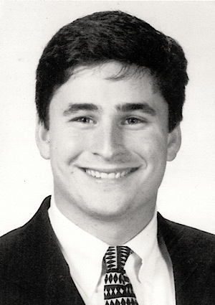

REMEMBERING BRAD FETCHET
11/17/76 – 9/1/2001
Bradley J Fetchet

Slide 4

93 COUNTRIES LOST CITIZENS
2977
Lost their lives

Slide 5
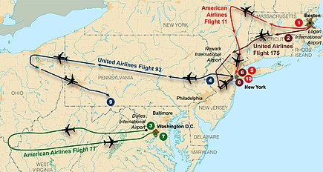
The United States Under Attack

Slide 6
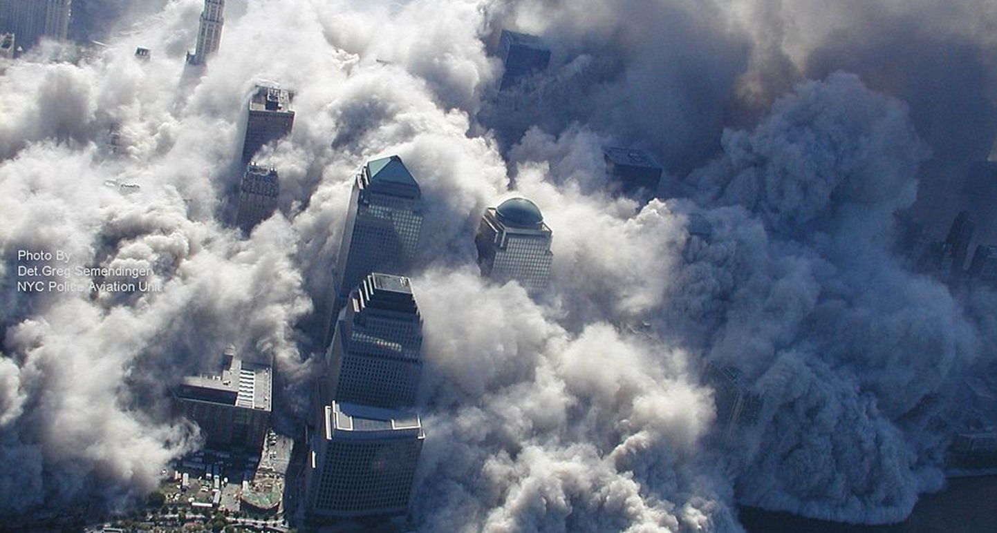
World Trade Center Site

Slide 7
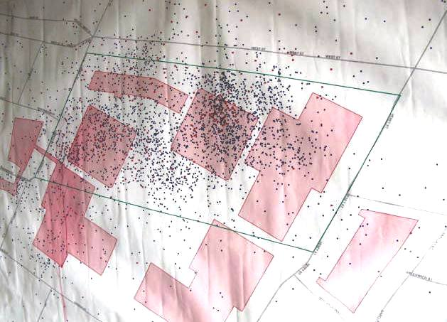
World Trade Center Site – 2,753 Victims

Slide 8
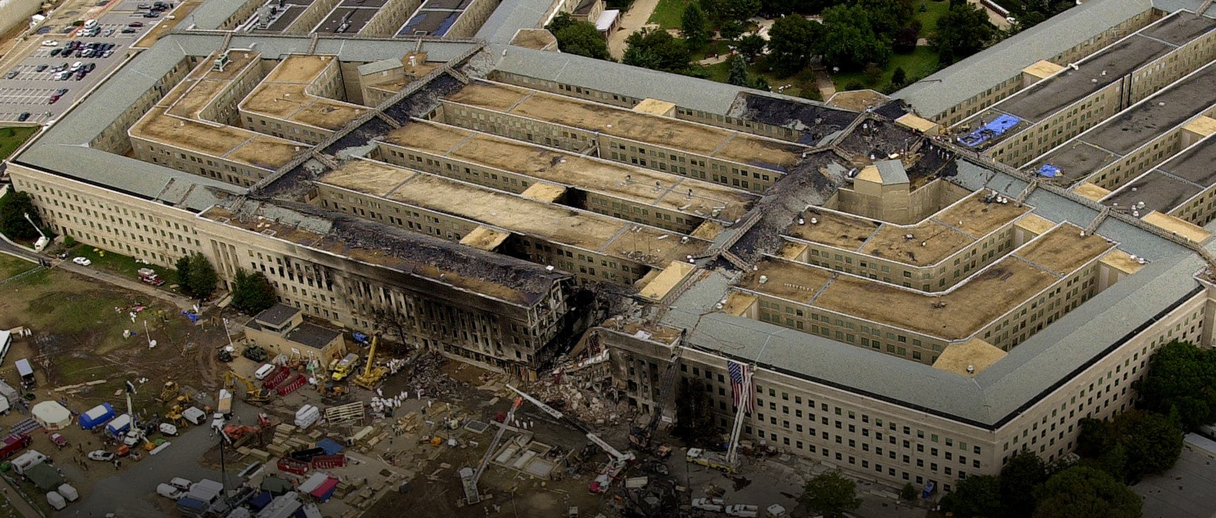
The Pentagon – 184 Victims

Slide 9
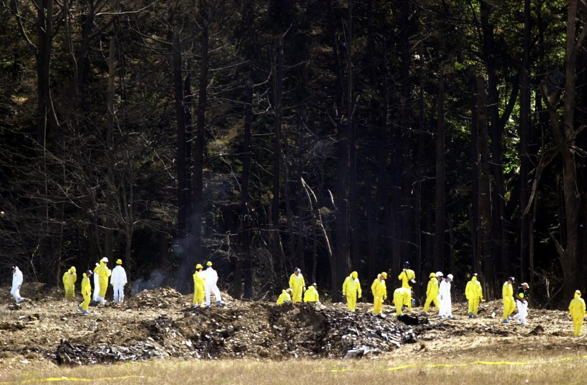
Shanksville, Pennsylvania – 40 Victims

Slide 10
VOICES CENTER FOR RESILIENCE –- 9/11 Response
Unique Responses to a Shared Tragedy
Family Assistance
Center
Rescue and Recovery
Identification of
Remains
Rebuilding
Memorial
New York – 2,753
Armory, Pier 94
moved 2/12/2002
9 months recovery effort - 9/11/01- 5/30/02
Ongoing efforts
$31 billion damage
Memorial 9/11/2011
Museum 5/14/2011
Pentagon - 184
Sheraton - 10/2001
Building repaired, employees working in room 1 year after
179 identified,
5 victims not identified
Room reopened 9/2002
Memorials inside and adjacent to Pentagon
Shanksville - 40
Onsite - Short-term
Completed in 13 days 9/14/2001
All 40 identified
Open field
Congress dedicated as National Memorial2002

Slide 11
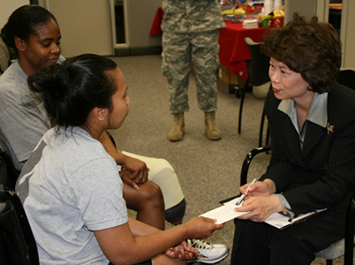
VOICES CENTER FOR RESILIENCE – Family Assistance
Family Assistance Center
Briefings and updated information
File missing persons report
Provide DNA samples
Social service support
Access legal advice
Apply for Financial support
Access local resources
Government services
Gathering with other victims’ families

Slide 12
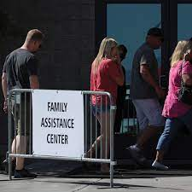
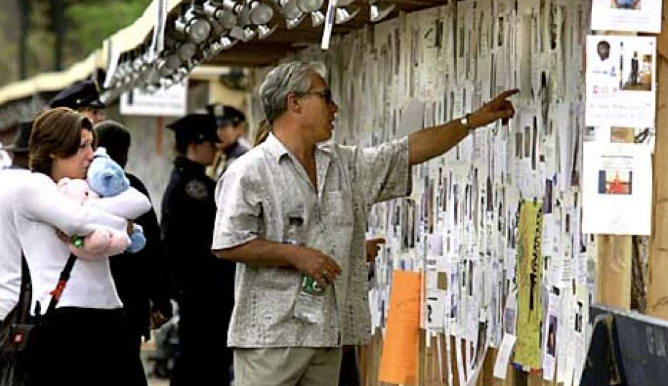
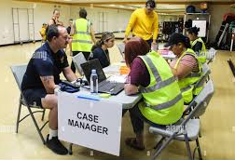
Family Assistance Centers Established
VOICES CENTER FOR RESILIENCE – Family Assistance
New York, NY – Armory, Pier 94 moved to Lexington Ave in February, 2002
Arlington, VA – Crystal City Sheraton Hotel - closed mid October, 2001
Shanksville, PA – Salvation Army, Red Cross, PA Dept Health & Human Services
Location of flights/airlines: Jersey City, Boston, San Francisco, Los Angeles, Chicago and Dallas

Slide 13
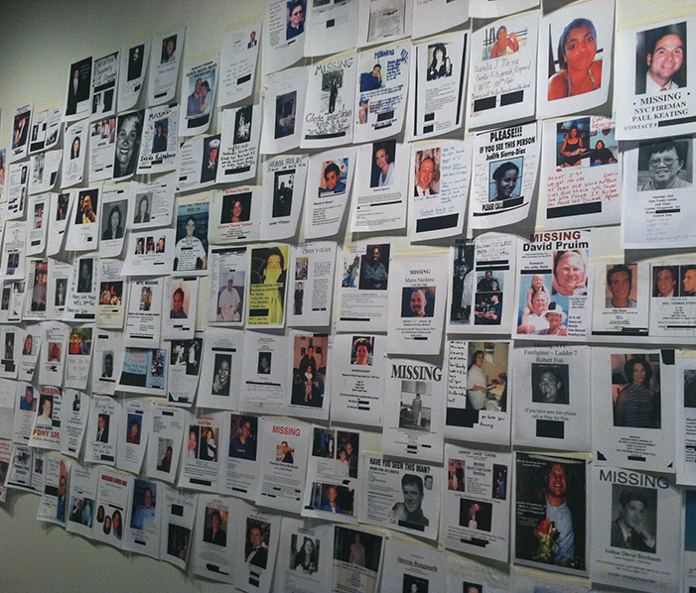
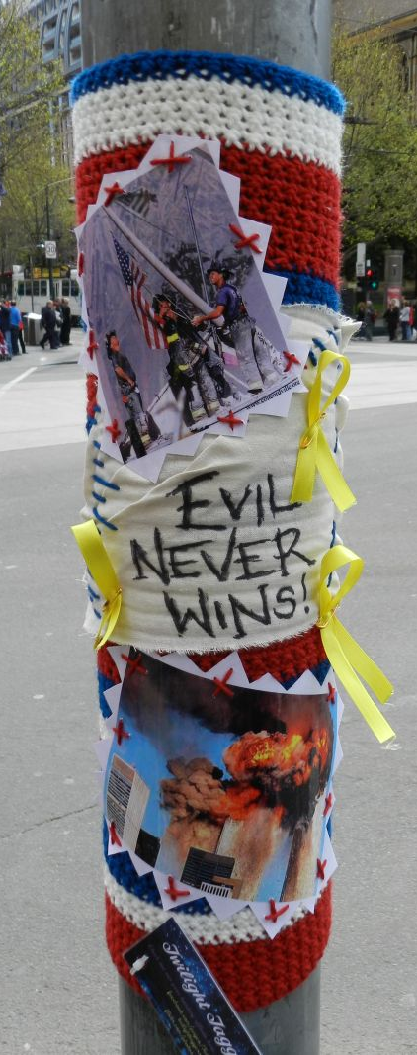
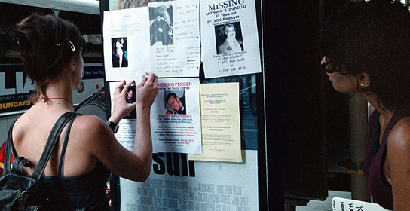
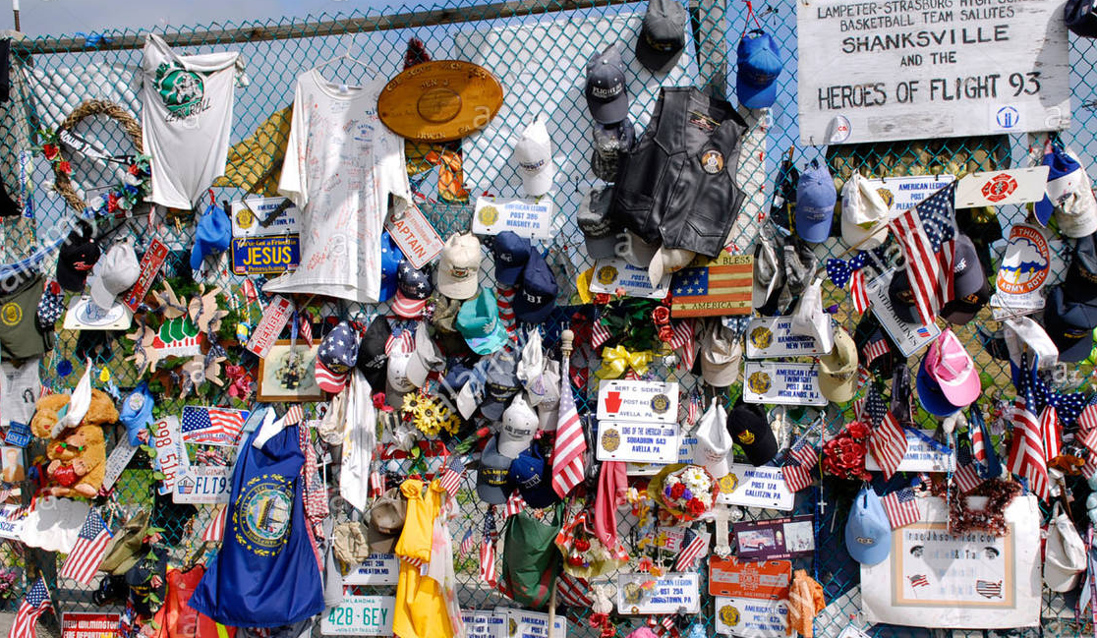
Spontaneous Memorials
VOICES CENTER FOR RESILIENCE – Family Assistance

Slide 14
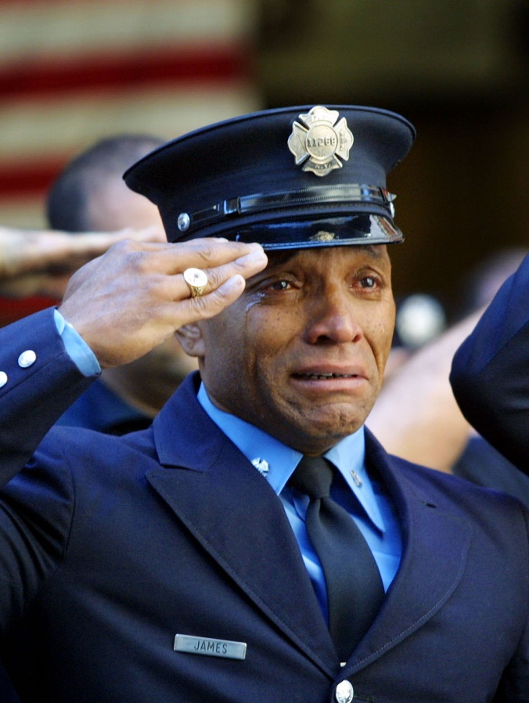
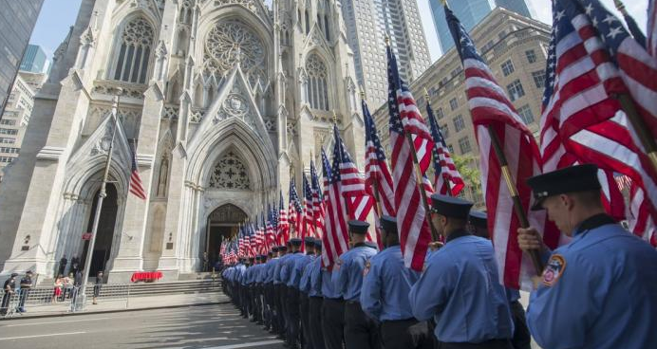
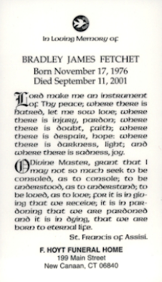
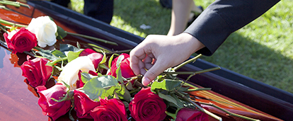
VOICES CENTER FOR RESILIENCE – Memorial Services
.

Slide 15
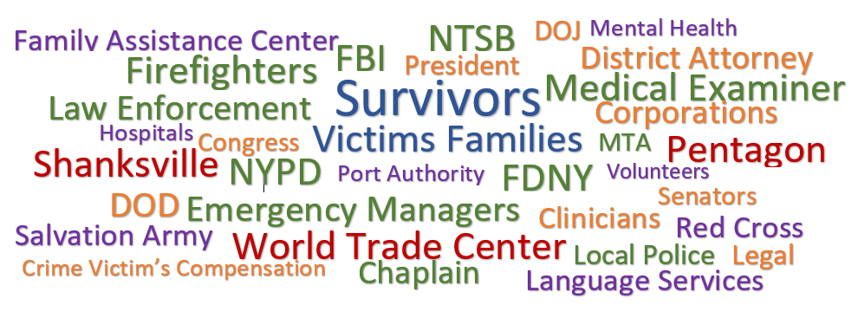
VOICES CENTER FOR RESILIENCE - Resources
Challenges identifying resources

Slide 16
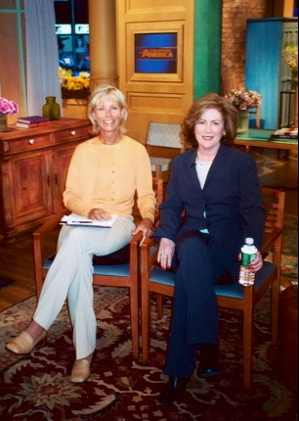

VOICES CENTER FOR RESILIENCE – Our Story
Founded in 2002 by 9/11 family members –
Mary Fetchet and Beverly Eckert,
Voices of September 11th is an advocacy group providing resources and support for victims’ families, survivors and all those impacted by the terrorist attack on September 11th.
Services include support groups, outreach, bereavement groups, lectures, workshops and special events

Slide 17
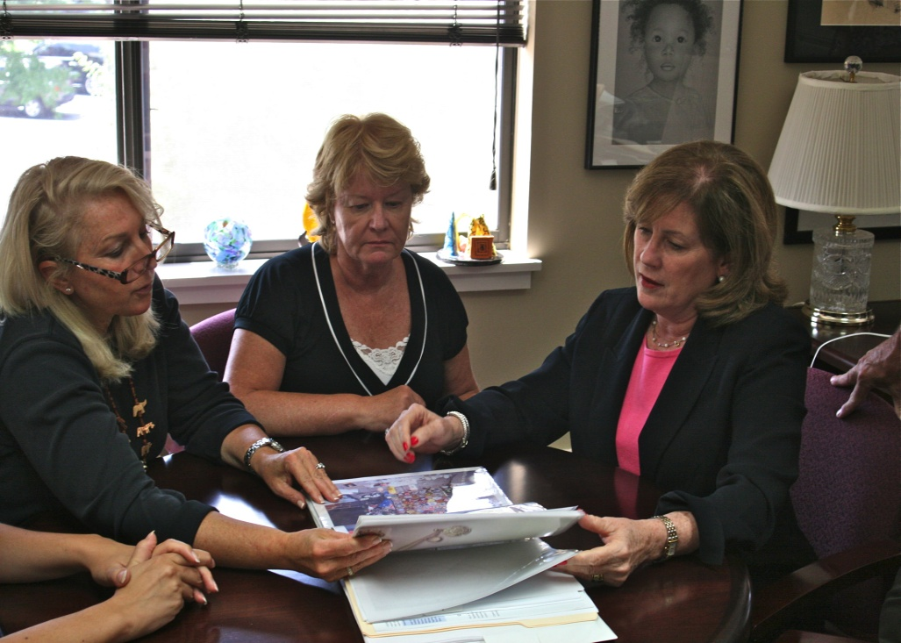
Providing a Holistic, Victim-Centered Approach
VOICES CENTER FOR RESILIENCE – Providing Support
Information
Assessments
Referrals
Support groups
Case management
Psychoeducational programs
Workshops and Conferences
9/10 Annual Information Forum
World Trade Center Health Program
9/11 Living Memorial Project

Slide 18

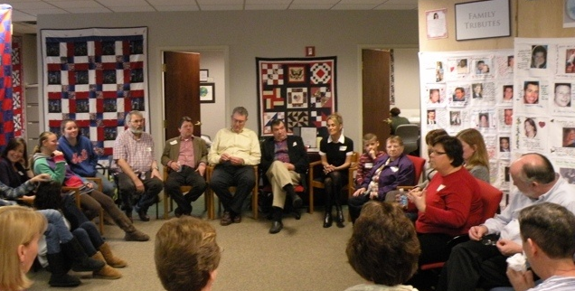
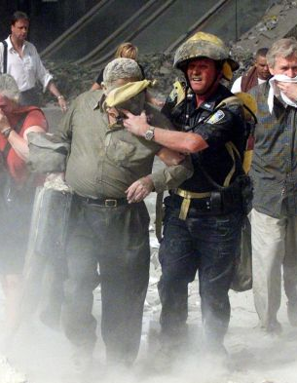
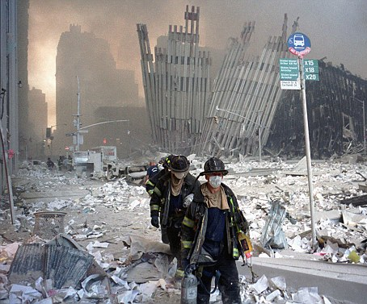
Defining the Circle of Impact
VOICES CENTER FOR RESILIENCE – Circle of Impact
COMMUNITY-AT-LARGE
RESPONDERS
WITNESSES
SURVIVORS
VICTIMS’
FAMILIES
VICTIMs
INJURED
SURVIVORS

Slide 19
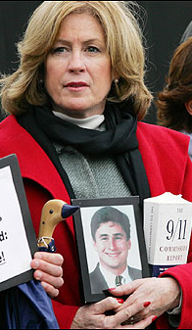
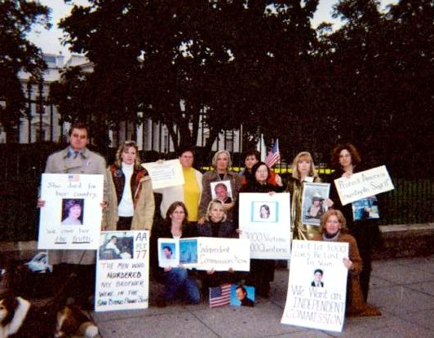
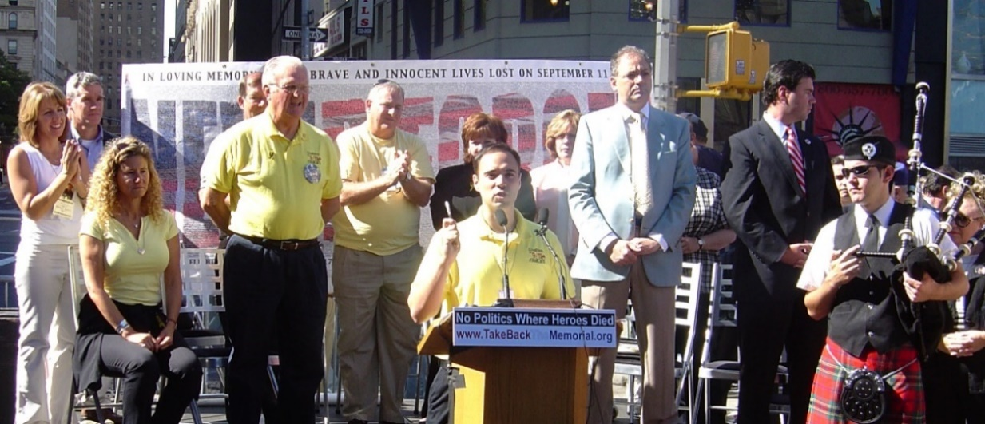
VOICES CENTER FOR RESILIENCE - Advocacy
Advocating for Reform
    9/11 Commission – Intelligence Reforms
    September as National Preparedness
    Notification of remains
    Victims Compensation Fund
    Zadroga Act - 9/11 responders & survivors
    Creating 9/11 Living Memorial
    9/11 Memorial Museum
    Memorial Glade for post 9/11 deaths
    Lawsuits Seeking Justice and Accountability

Slide 20
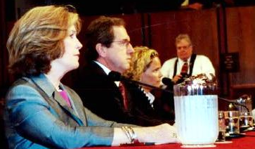
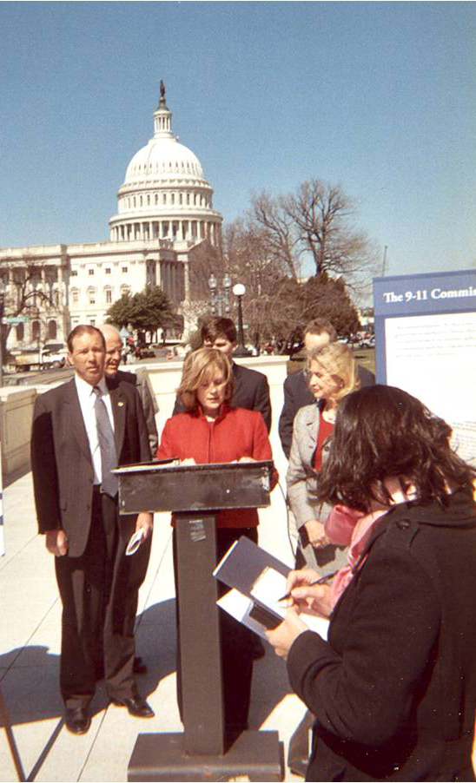
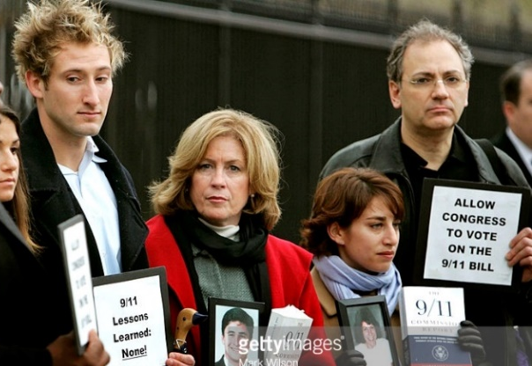
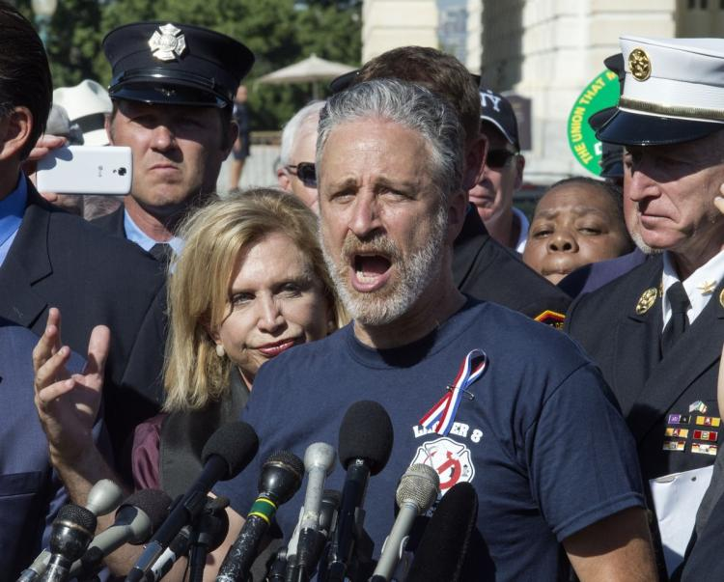
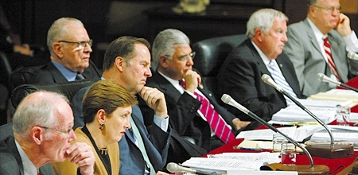
VOICES CENTER FOR RESILIENCE - Advocacy

Slide 21
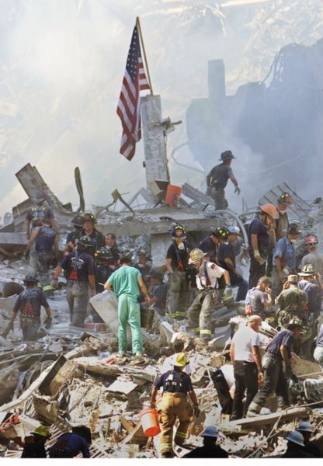
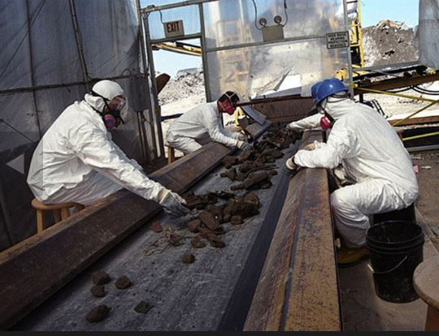
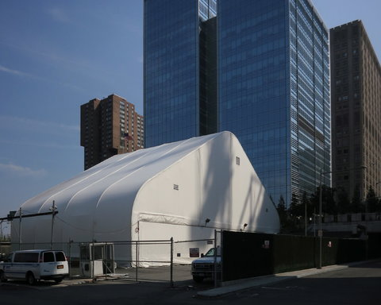
VOICES CENTER FOR RESILIENCE – Advocacy
    Identification and notification process is ongoing
    19,500 human remains found
    1,650 of the 2,753 WTC victims identified
    1,103 victims have not been identified
    Families may have multiple notifications delayed burial

Slide 22
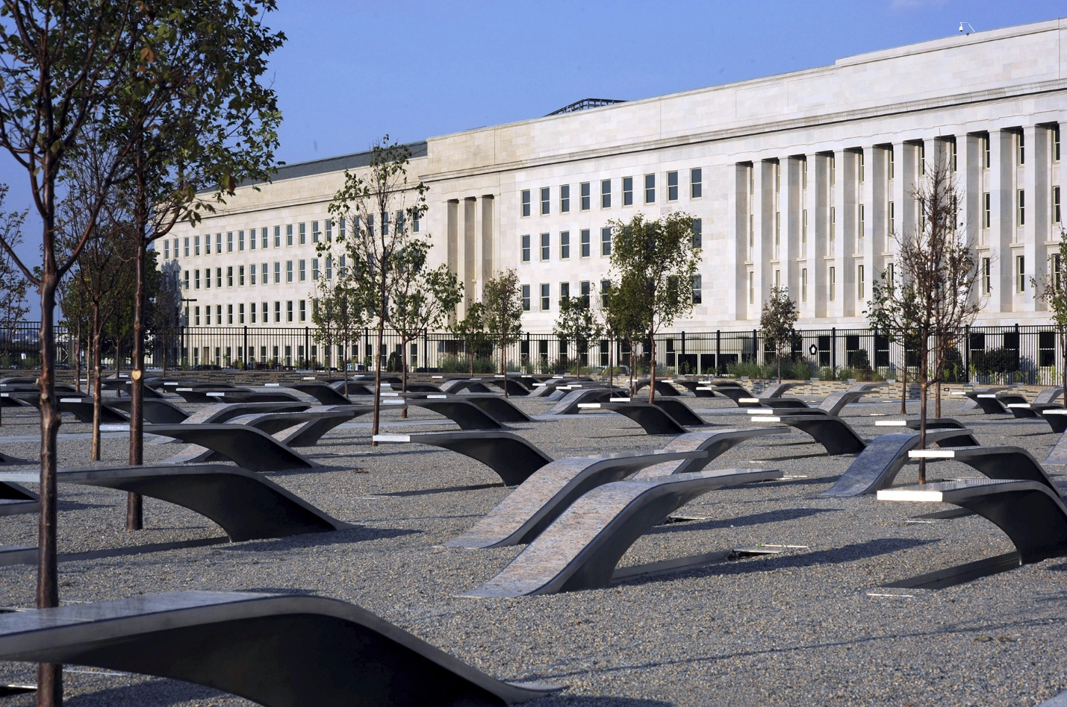
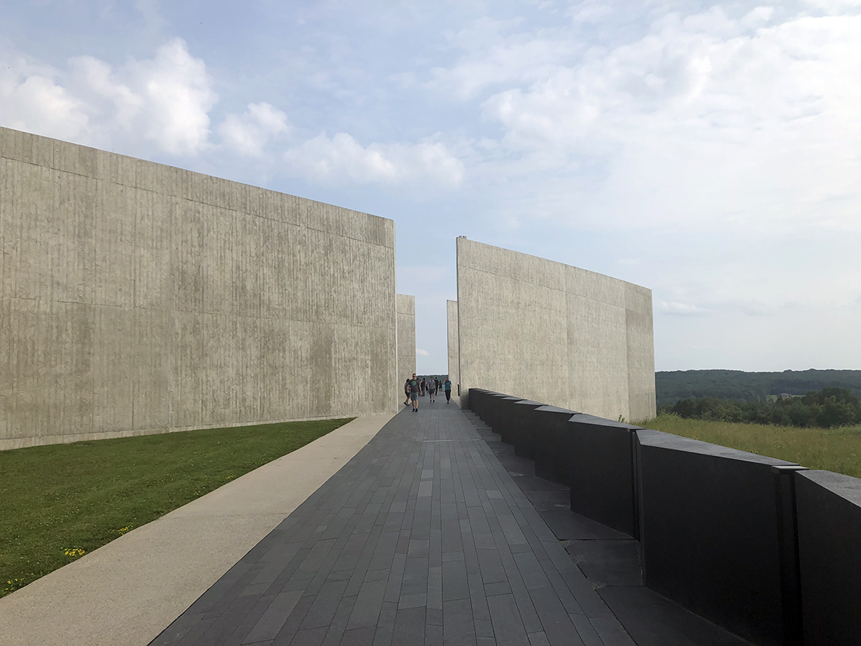
Identification & Notification of Remains
VOICES CENTER FOR RESILIENCE – Advocacy
    Pentagon
Shanksville, PA

Slide 23
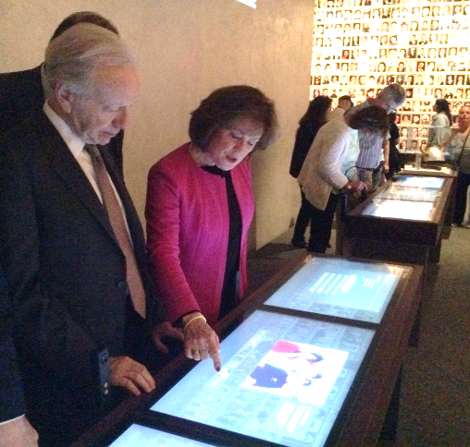
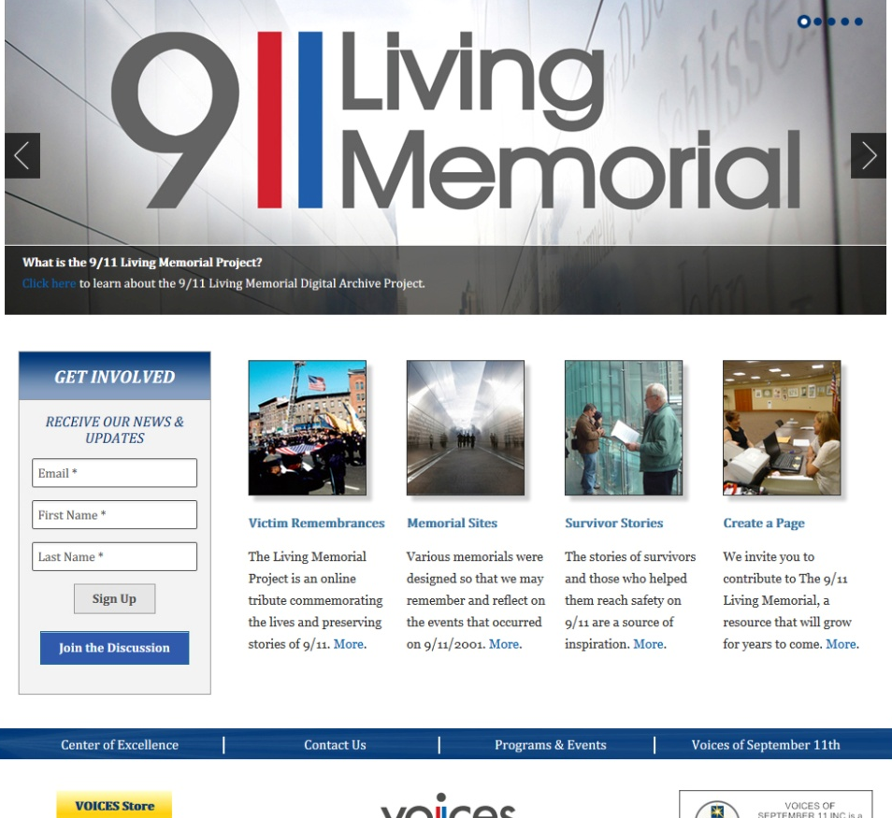
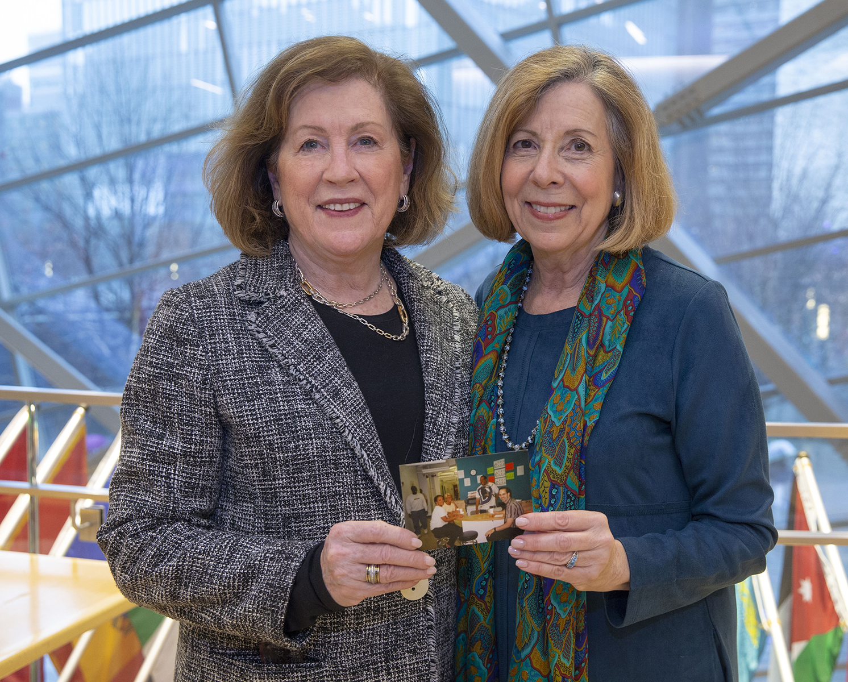
VOICES CENTER FOR RESILIENCE – Commemoration
9/11 Living Memorial
Commemorating the lives and stories of 9/11

Slide 24
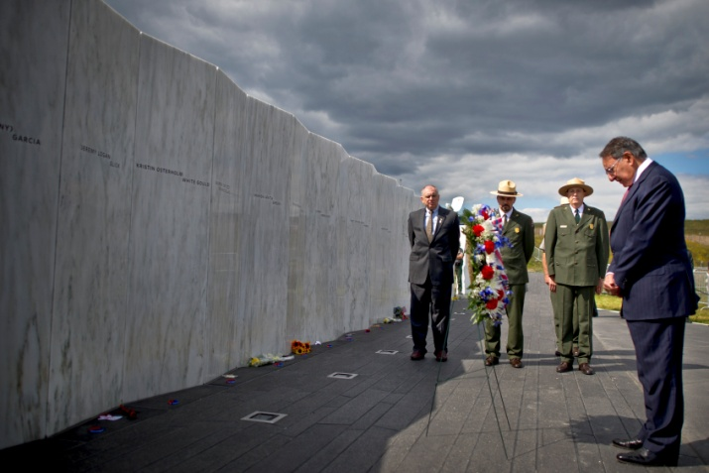
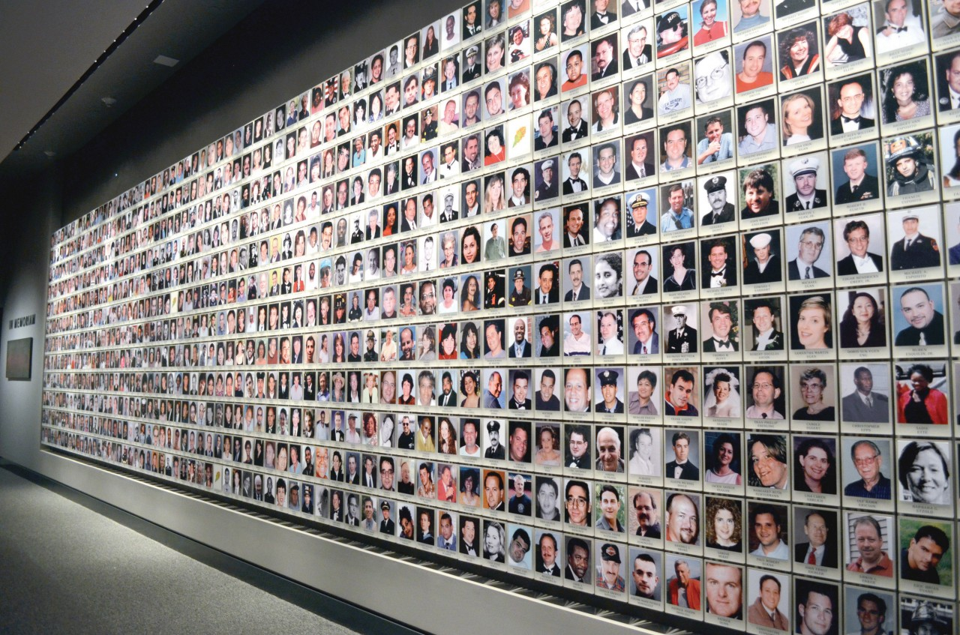
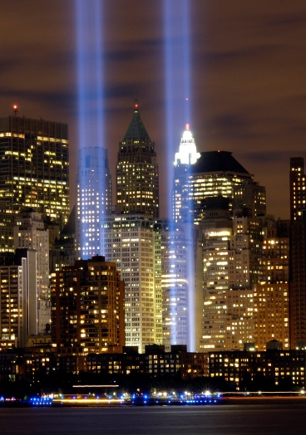
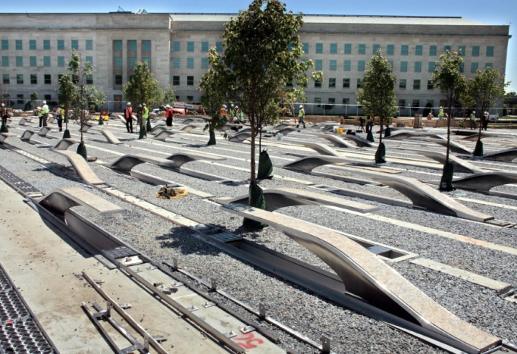
VOICES CENTER FOR RESILIENCE – Commemoration

Slide 25
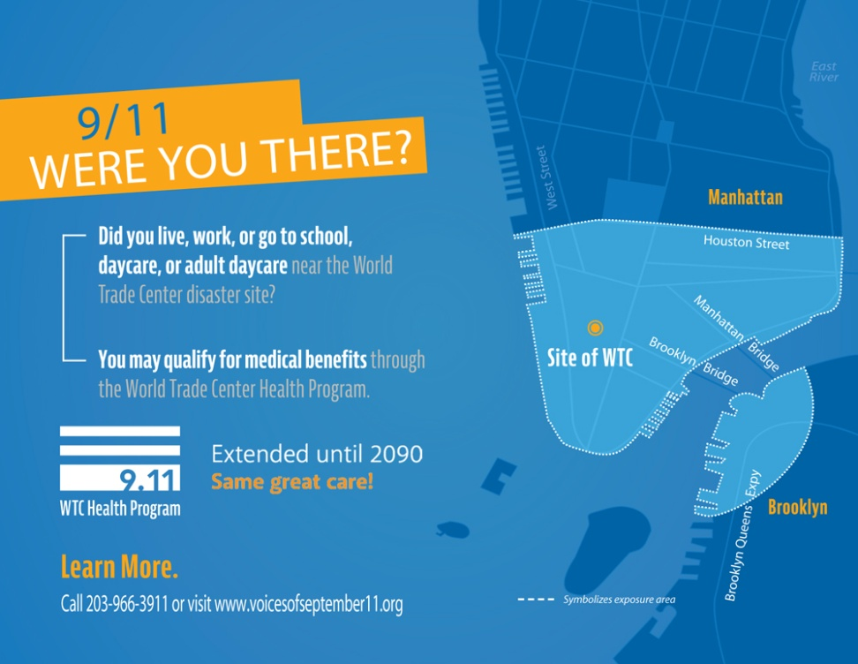
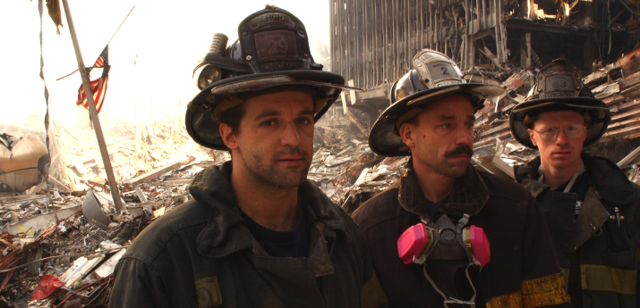
VOICES CENTER FOR RESILIENCE – Survivors & Responders
World Trade Center Health Program
Providing medical care
and mental health treatment
for 9/11 responders and survivors

Slide 26
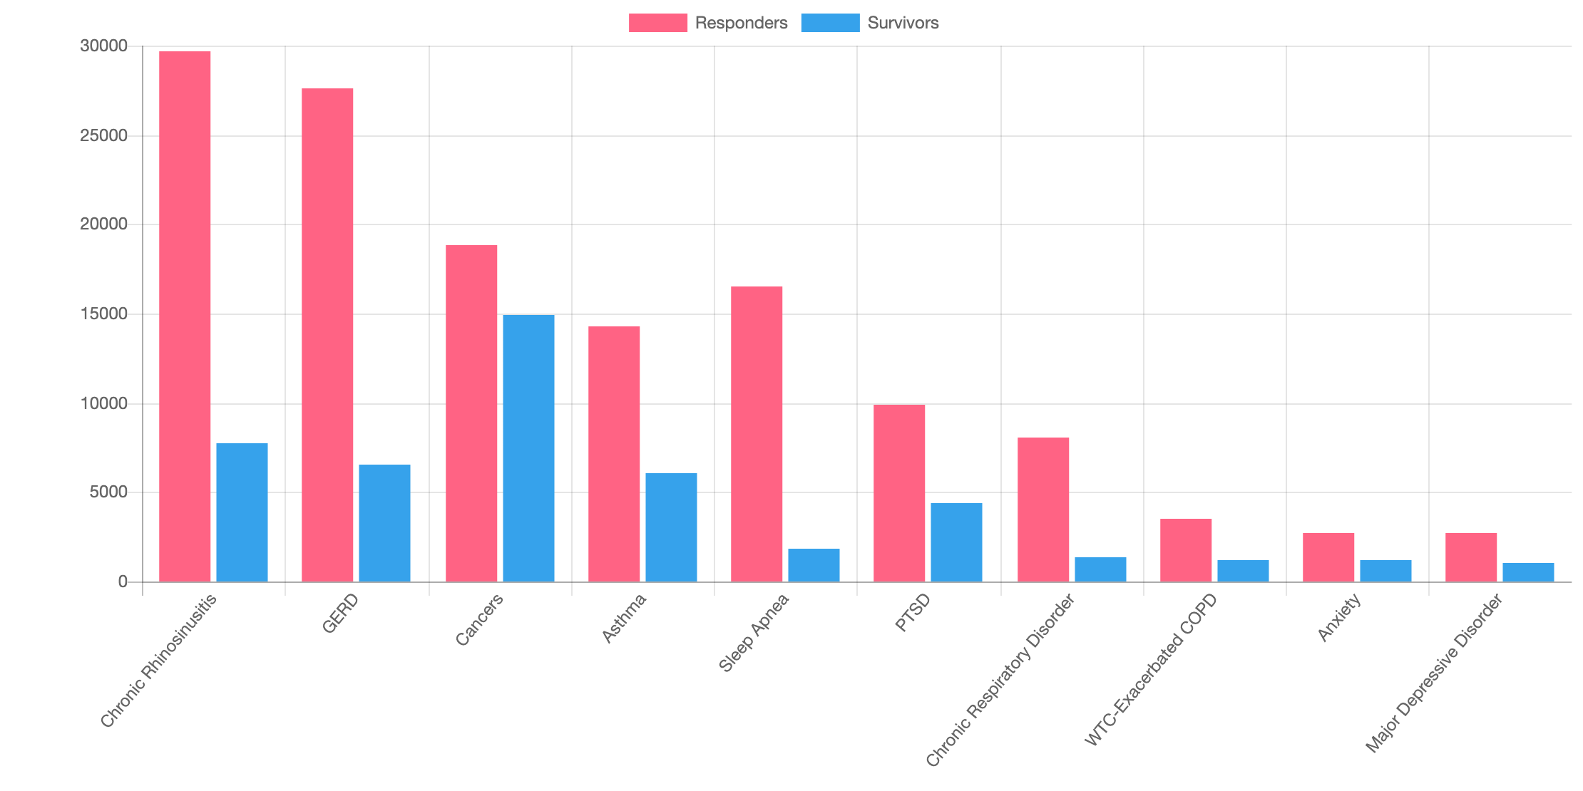
Top 10 Certified Conditions
VOICES CENTER FOR RESILIENCE – Survivors & Responders
cdc.gov image

Slide 27
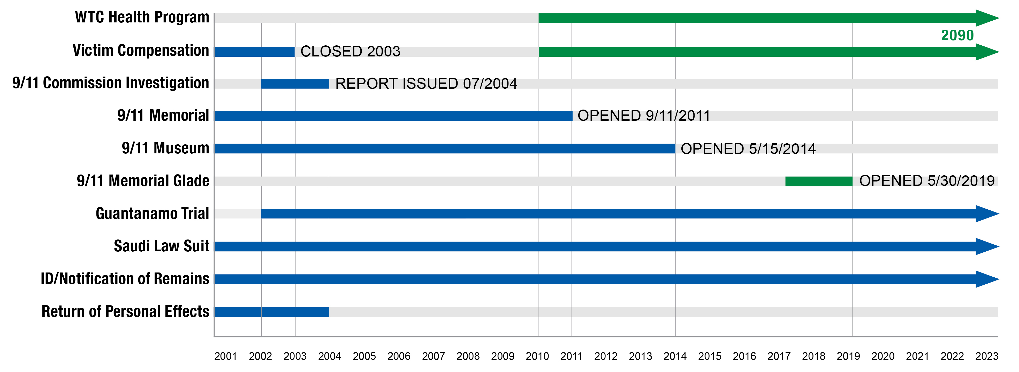
VOICES CENTER FOR RESILIENCE – 9/11 Timeline

Slide 28

VOICES CENTER FOR RESILIENCE TODAY
From 9/11 to today, VOICES provides long-term support services and access to mental health care and resources for thousands of victims’ families, responders, and survivors.
We are equally committed to collaborate with our partners to help communities prepare for, respond to, and recover from tragedy, in the United States and abroad.

Slide 29

VOICES PROGRAMS

Slide 30

VOICES EDUCATION
Webinars, Presentations, Conferences and Annual Symposium

Slide 31






VOICES NEW YORK CITY SYMPOSIUM

Slide 32



VOICES TRAINING
Community Preparedness Training:
A Victim-Centered Approach

Slide 33

VOICES CENTER FOR RESILIENCE
Self-care is giving the world the best of you, instead of what’s left of you. - Katie Reed

Slide 34
VOICES CENTER FOR RESILIENCE
THANK YOU!
Mary Fetchet, LCSW Frank Fetchet
Founding Director Chief Operating Officer
mafetchet@voicescenter.org ffetchet@voicescenter.org
VoicesCenter.org | 203.966.3911

